Slide 1

Unit II : Diffie-Hellman
Refer
Chapter 15 , forouzan
Copyright © The McGraw-Hill Companies, Inc. Permission required for reproduction or display.
15.<number>

Slide 2
Chapter 15
Objectives
To explain the need for a key-distribution center
To show how a KDC can create a session key
To show how two parties can use a symmetric-key
agreement protocol to create a session key
To describe Kerberos as a KDC and an
authentication protocol
To explain the need for certification authorities
for public keys
To introduce the idea of a Public-Key
Infrastructure (PKI) and explain some of its duties
15.<number>

Slide 3

15.1.2 Session Keys
A KDC creates a secret key for each member. This secret key can be used only between the member and the KDC, not between two members.
Note
A session symmetric key between two parties is used only once.
15.<number>

Slide 4
15-3 SYMMETRIC-KEY AGREEMENT
Alice and Bob can create a session key between themselves without using a KDC. This method of session-key creation is referred to as the symmetric-key agreement.
Topics discussed in this section:
15.3.1 Diffie-Hellman Key Agreement
15.3.2 Station-to-Station Key Agreement (not in syllabus)
15.<number>

Slide 5
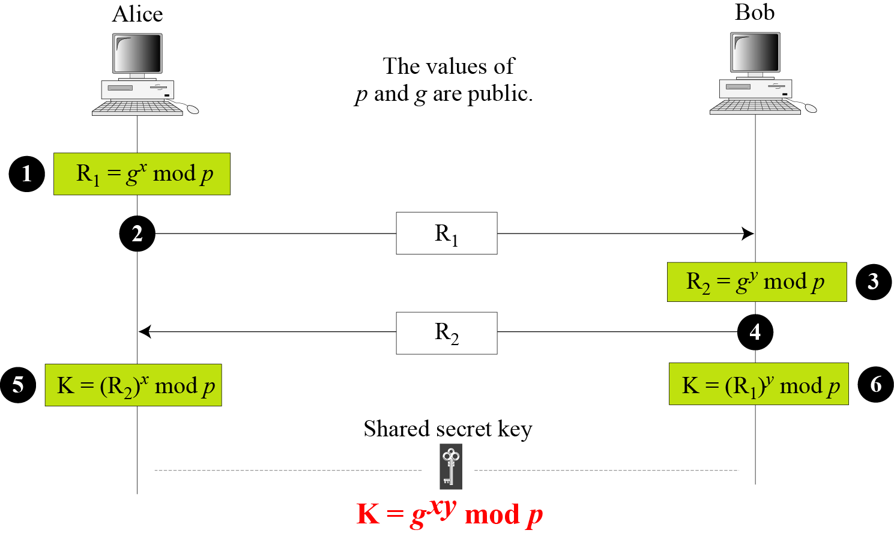
15.3.1 Diffie-Hellman Key Agreement
Figure 15.9 Diffie-Hellman method
15.<number>

Slide 6
15.3.1 Continued
Note
The symmetric (shared) key in the Diffie-Hellman method is K = g^{xy} mod p.
15.<number>

Slide 7
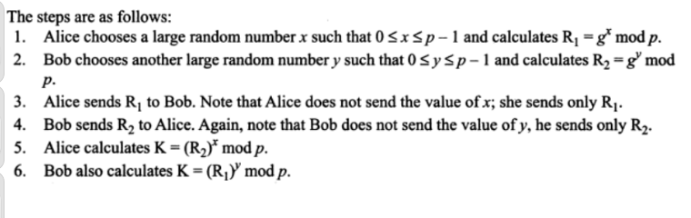
15.<number>

Slide 8
15.3.1 Continued
Example 15.1
Let us give a trivial example to make the procedure clear. Our example uses small numbers, but note that in a real situation, the numbers are very large. Assume that g = 7 and p = 23. The steps are as follows:
Alice chooses x = 3 and calculates R₁ = 7³ mod 23 = 21.
Bob chooses y = 6 and calculates R₂ = 7⁶ mod 23 = 4.
Alice sends the number 21 to Bob.
Bob sends the number 4 to Alice.
Alice calculates the symmetric key K = 4³ mod 23 = 18.
Bob calculates the symmetric key K = 21⁶ mod 23 = 18.
The value of K is the same for both Alice and Bob;
g^{xy} mod p = 7¹⁸ mod 35 = 18.
15.<number>

Slide 9
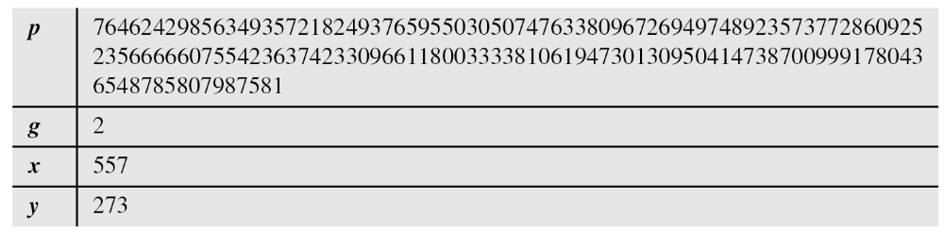
15.3.1 Continued
Example 15.2
Let us give a more realistic example. We used a program to create a random integer of 512 bits (the ideal is 1024 bits). The integer p is a 159-digit number. We also choose g, x, and y as shown below:
15.<number>

Slide 10
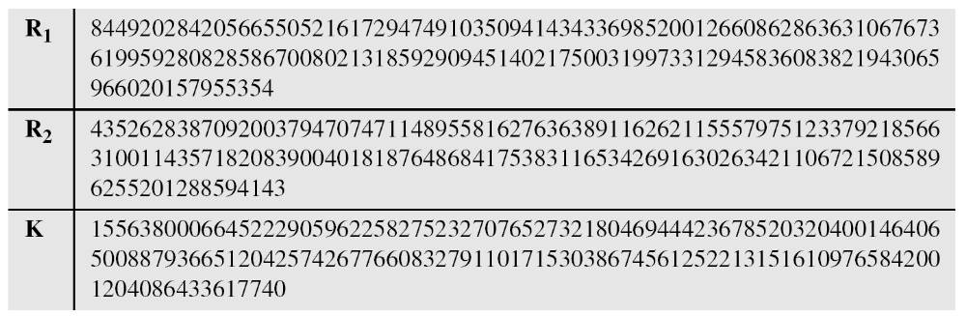
15.3.1 Continued
Example 15.2
Continued
The following shows the values of R₁, R₂, and K.
15.<number>

Slide 11
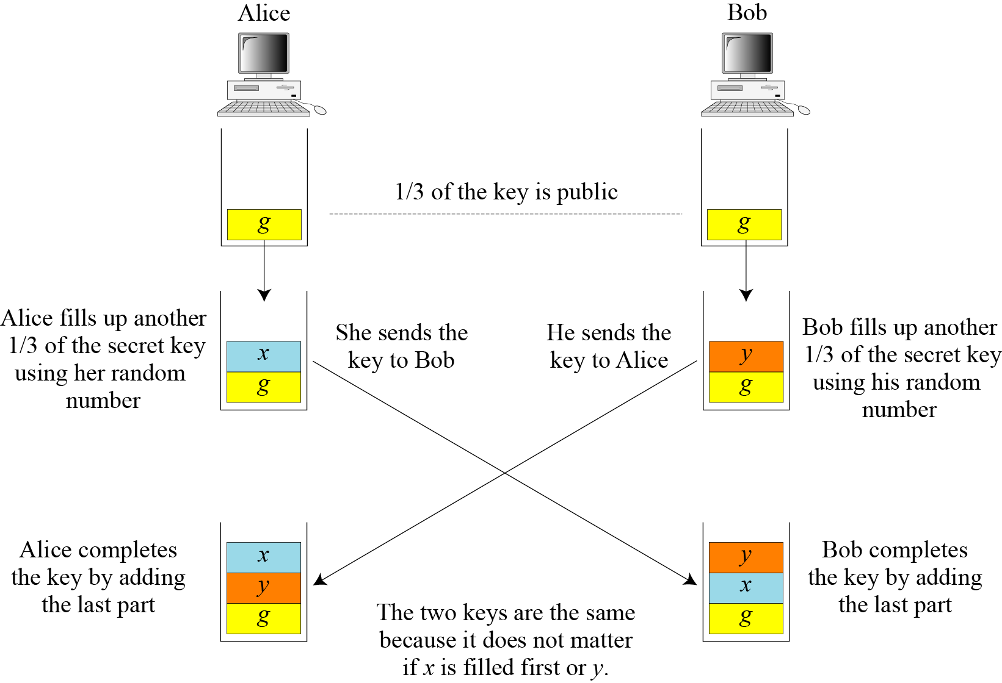
15.3.1 Continued
Figure 15.10 Diffie-Hellman idea
15.<number>

Slide 12
15.3.1 Continued
Security of Diffie-Hellman
Discrete Logarithm Attack
Man-in-the-Middle Attack
15.<number>

Slide 13
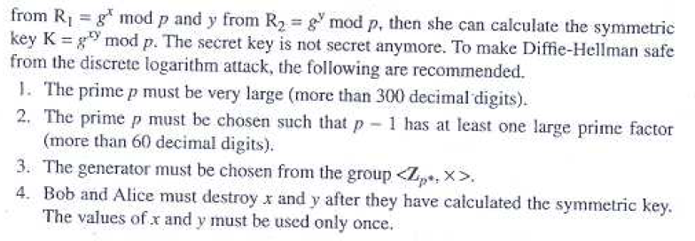
Discrete Logarithm Attack
15.<number>

Slide 14
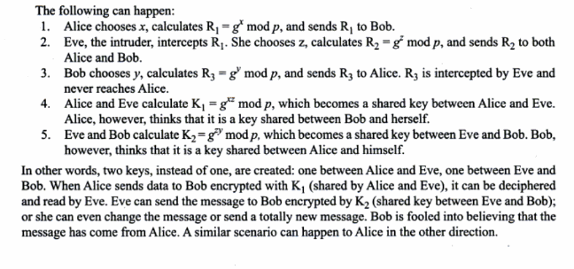
Man-in-the-Middle Attack
15.<number>

Slide 15
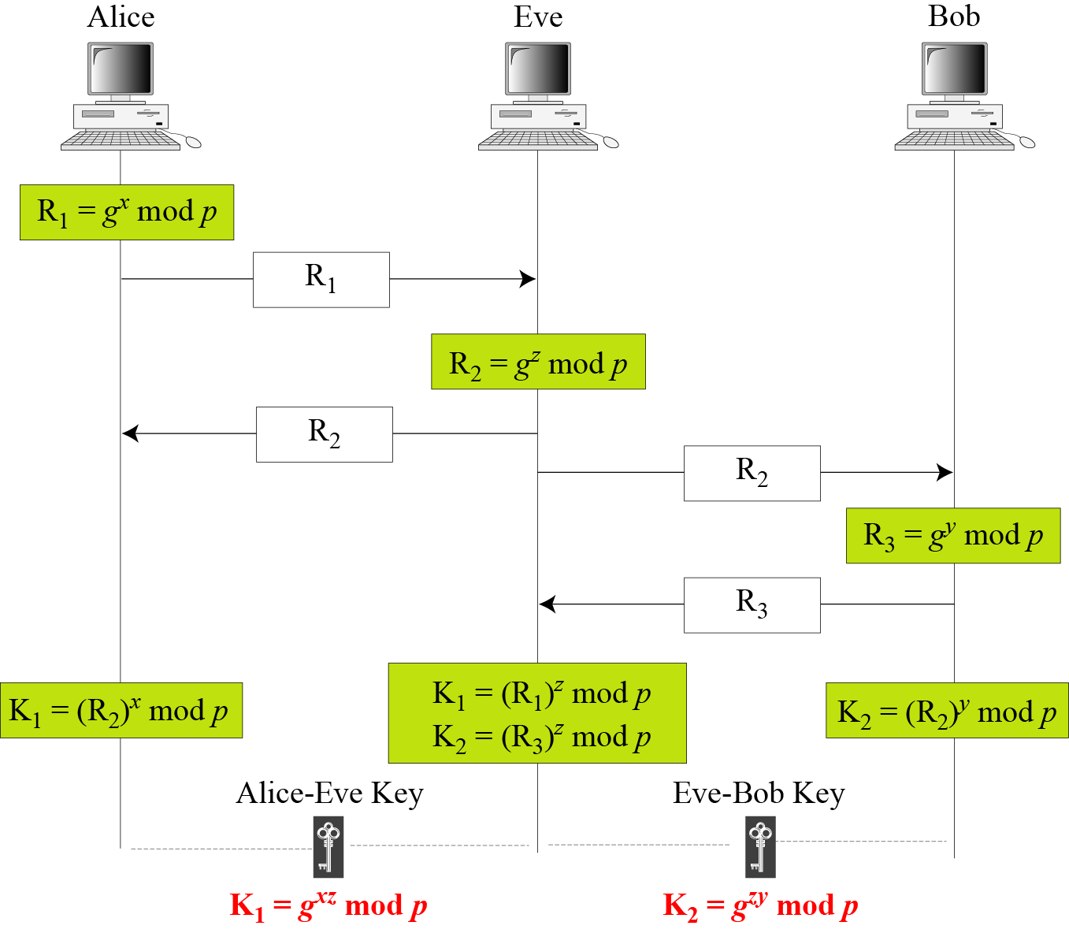
15.3.1 Continued
Figure 15.11 Man-in-the-middle attack
15.<number>

Slide 16
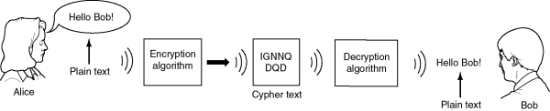
Example
Two Internet users, Alice and Bob wish to have a secure conversation.
  They decide to use the Diffie-Hellman protocol

Slide 17
Example
Alice and Bob get public numbers
  P = 23, G = 9
Alice and Bob compute public values
  X = 9⁴ mod 23 = 6561 mod 23 = 6
  Y = 9³ mod 23 = 729 mod 23 = 16
Alice and Bob exchange public numbers

Slide 18
Example
Alice and Bob compute symmetric keys
  k_{a} = yª mod p = 16⁴ mod 23 = 9
  k_{b} = x^{b} mod p = 6³ mod 23 = 9
Alice and Bob now can talk securely!

Slide 19
Applications
Diffie-Hellman is currently used in many protocols, namely:
  Secure Sockets Layer (SSL)/Transport Layer Security (TLS)
  Secure Shell (SSH)
  Internet Protocol Security (IPSec)
  Public Key Infrastructure (PKI)

Slide 20
Conclusion
Authenticated Diffie-Hellman Key Agreement (1992)
  Defeats middleperson attack
Diffie-Hellman POP Algorithm
  Enhances IPSec layer
Diffie-Hellman continues to play large role in secure protocol creation

Slide 21

Additional Sources
http://www.sans.org/rr/encryption/algorithm.php
http://www.hack.gr/users/dij/crypto/overview/index.html

